Slide 1
Welcome Bathurst High School Graduating Class of 2022

Slide 2
Registration Timeline
April
Initial Registration
April/May
Discuss course selection with parents, employers, teachers and counsellors.
June
After report cards, students are able to make necessary changes.

Slide 3
Levels?

Slide 4
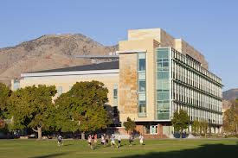
Levels 2
Level 2 (e.g. English 112)
These courses satisfy entrance requirements for university and some community college/tech school programs.

Slide 5
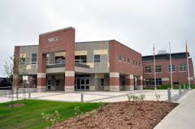
Levels 3
Level 3 (e.g. English 113)
These courses satisfy entrance requirements for some community college and many private school programs. Also, for students who plan to make the transition directly from high school to the world of work.

Slide 6
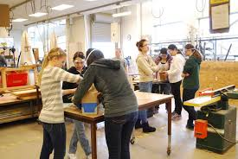
Levels 0
Level 0 (e.g. Geography 110)
These courses are open to any student and also include special areas of interest.

Slide 7
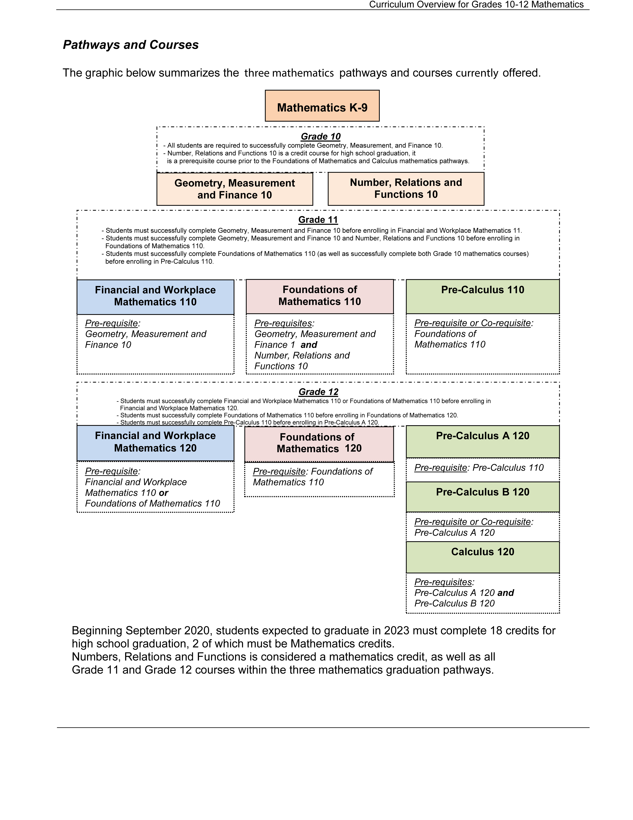
Math Pathways

Slide 8
Distance Education
DE is taught on computers in the BBT Lab 137.
Different Levels Mod Hist 111, Mod Hist 113
https://www2.gnb.ca/content/gnb/en/departments/education/k12/content/anglophone_sector/elearning/distance.html

Slide 9
Summary of Credits 2022
Compulsory Credits |  |  |  |  |  |  | Mark | 1/2
1&2 | Eng 112 |  | Eng 113
3 | Eng 122 |  | Eng 123
4 | Foundations of Math 110 |  | Fin& Workplace Math 110
5 | Mod. His 112 |  | Mod. His 113 |  | FIHist 110
6 | Science | See (A) Below
7 | Life Role Devel | See (B) Below
z
A Science
Physics 112/122
Chem. 112/122
Bio. 112/122
Human Physiology 110
Phys. Geography 110
Intro Env. Science 120
Auto Electrical 120
Intro to Electronics 110
B Life Role Development
Coop 120
Entrepreneurship 110
Family Living 120
Graphic Art 110
Fashion Tech 110
Wellness Through Phys. Ed. 110
Music 112/113/122/123/120
Health Care 110
Nutrition 120
Physical Education Leadership 120
Trades/Tech course (11 or 12)
Theatre Arts 120
Visual Art 110/120 or Fine Art 110
Outdoor Pursuits 110
Notes:
I removed Career Exploration 110 for 2016-17

Slide 10
Elective Credits |  |  |  |  |  |  | Mark | 1/2
8
9
10
11
12
13
14
15
16
17
17 Credits Required for Graduation MUST COMPLETE Five Grade 12 courses
18
29
20

Slide 11
Provincial French Immersion Certificate Requirements
Grade 9 and 10
Completion of outcomes as required by the Province of NB.
Grade 11 and 12
(5 credits in total)
FIL 110
FI Mod History 112
FIL 120
2 FI Electives

Slide 12
Provincial Oral Proficiency Rating Requirements
Any students who have chosen to complete French Language courses in grade 11 & 12 will be given an Oral Proficiency Certificate with a standard rating.
If you would like to be tested and did not take a French course in grade 11 or 12 please meet with Ms. Stacey Vanbuskirk in room 316

Slide 13
Course Planning Guide
Grade 11
1. ______________
2. ______________
3. ______________
4. ______________
5. ______________
6. ______________
7. ______________
8. ______________
9. ______________
10. _____________
Grade 12
1. ______________
2. ______________
3. ______________
4. ______________
5. ______________
6. ______________
7. ______________
8. ______________
9. ______________
10. _____________

Slide 14
Course Plan (example)
Grade 11 Grade 12
1. English 113 A 1. English 123
2. English 113 B 2. World Issues 120
3. Fin Work 120 3. Media Studies 120
4. Hist 113 4. Power Train 110
5. Music 113 5. Auto Electrical 120
6. Wellness 110 6. Tune Up and Trade 120
7. Engines 110 7. Digital Productions 120
8. Framing 110 8. Mill and Cabinet 120
9. Early Child 110 9. CO-OP 120
10. Human Physio 110 10. CO-OP 120

Slide 15
Course Plan (example)
Grade 11
1. English 112
2. English 112
3. Foundation of Math 11
4. Pre-Calculus 11
5. Wellness 110
6. Mod. History 112
7. Graphic Arts 110
8. Biology 112
9. Chemistry 112
10. Physics 112
Grade 12
1. English 122
2. Pre-Calculus 12A
3. Pre-Calculus 12B
4. Calculus 12
5. Poli Sci 120
6. Chemistry 122
7. Physics 122
8. Phys. Ed Leadership 120
9. Theatre Arts 120
10. Economics 120

Slide 16
It is our hope that this presentation will assist you in making wise decisions concerning your course planning and ultimately your future.
If you have any questions or concerns during any of this process, please go to the Guidance Office to meet with Mrs. Shirley Riordon or Ms. Janice Hache.
If parents have any questions:
Mrs. Riordon’s office number is 547-2663 and email shirley.riordon@nbed.nb.ca
Ms. Hache’s office number is 547-7618 and email is
janice.hache@nbed.nb.ca

Slide 17
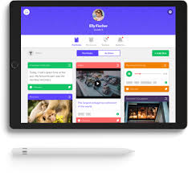
myBlueprint.ca
Need help deciding your career path? Use this software
to guide you. See link on the BHS Website.
Visit – myBlueprint.ca/anglophonenorth
1. Click “Sign Up” 1. LOGIN
2. Select “Your School” or 2. USERNAME@NBSS.NBED.NB.CA
+ Create an Account Password: (Birthday and Year) example: AUGUST152002

Slide 18
myBlueprint.ca is an online career information delivery system that helps students build powerful plans in their personal portfolio as they compare, connect, and choose from a vast network of work and education options.

Slide 19
High School Pre-Apprenticeship

Slide 21
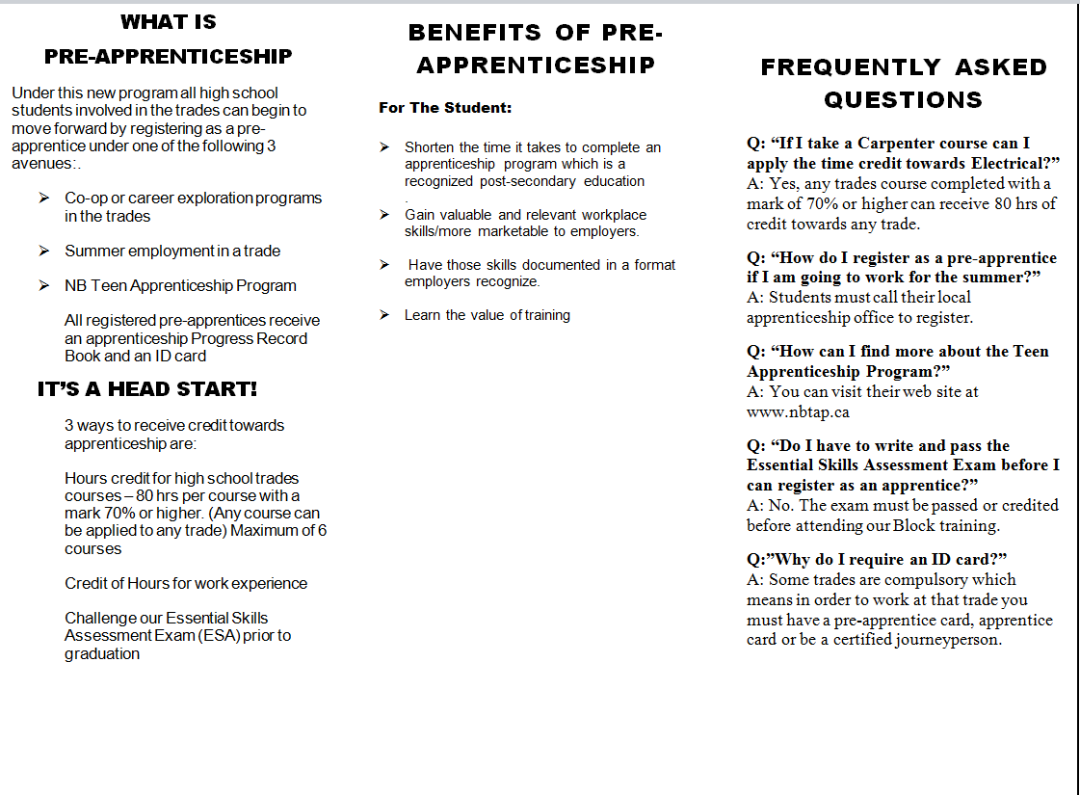

Slide 22
Road Map to Trade Certification - High School Students
Coop Students
Apprenticeship
Pre-employment
Students apply for Cooperative Education Program:
Complete Application Form
Complete/submit research on career of interest
Obtain/submit teacher references (at least 2)
Interview by Cooperative Education teacher
Direct to work - Obtain Employment
Complete Pre-Employment Course
Register as an Apprentice
ESA Exam
Transcription of Marks
Pre-Apprentice PR Book
ESA Exam
Block 1
Exam
Successful students complete 3-week Pre-employment
component prior to placement with employer.
Complete On-the-Job Hours
Attend Block Training
Obtain Employment
Register as pre-apprentice
Block 1
Exam
Register as an Apprentice
ID Card & Progress Record Book
Transcript of marks,
Pre- apprentice PR Book
Return to work
Work Term Hrs & Theory Hrs-Credits
Complete On-the-Job Hours
Attend Block Training
Attend Block Training
ESA Exam
Block 2
Exam
Process Repeats for
Blocks 3-5
Return to work
High School Graduation
Attend Block Training
Apprenticeship
Pre-employment
Cert.
Exam
Diploma of Apprenticeship & Certificate of Qualification

Slide 23
Good Luck on Your Journey!
Make sure you check out our BHS Website, BHS Teams and BHS Facebook for more information!!

Slide 24
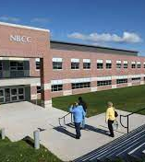
NBCC New Brunswick Community College
There are many campuses in NB
https://nbcc.ca/
Start applying April 1st of your Grade 11 year
Make sure you meet the admission requirements

Slide 25
Holland College (PEI)
https://www.hollandcollege.com/
Start applying in September of your Grade 12 year
Make sure you meet the admission requirements

Slide 26
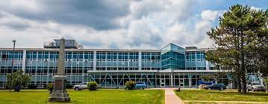
Nova Scotia Community College (NSCC)
There are several campuses and many programs
https://www.nscc.ca
Start applying September 1st of your Grade 11 year
Make sure you meet the admission requirements

Slide 27
University of New Brunswick
There are 2 campuses: Fredericton and Saint John
https://www.unb.ca/
Start applying October 1st of your Grade 12 year
Make sure you meet the admission requirements

Slide 28
Dalhousie University
There are 2 campuses: Halifax and Truro
https://www.dal.ca
Start applying October 1st of your Grade 12 year
Make sure you meet the admission requirements

Slide 29
University Academic Credits
English 122
Math 120
Pre-Cal 12A & B
French 12
Economics 120
Political Science 120
Canadian Literature 120
Canadian History 122
Environmental Science 120
Physics 122
Chemistry 122
Biology 122

Slide 30
https://sisasdn.nbed.nb.ca/public/home.html
POWERSCHOOL Link – open the link then go to the left side of the screen to the class registration button. You will need to click the pencil on the right hand side of the screen to start the process of registration.

